Slide 1

Hospital Management System
A comprehensive system for managing hospital operations efficiently.

Slide 2

Introduction

Slide 3
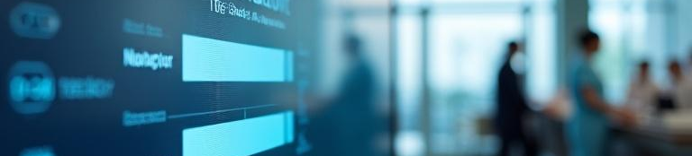
01
Login & Reception

Slide 4
Login Page Functionality
The login page serves as the entry point for users, requiring a username and a password for authentication. This ensures that only authorized personnel can access the hospital management system, safeguarding sensitive patient information and administrative functions.

Slide 5
Reception Interface Overview
Upon successful login, users are directed to the reception interface, which includes various modules such as adding new patients, managing rooms, departments, and employee details. This interface streamlines the reception tasks, enabling efficient patient flow and resource management within the hospital.

Slide 6
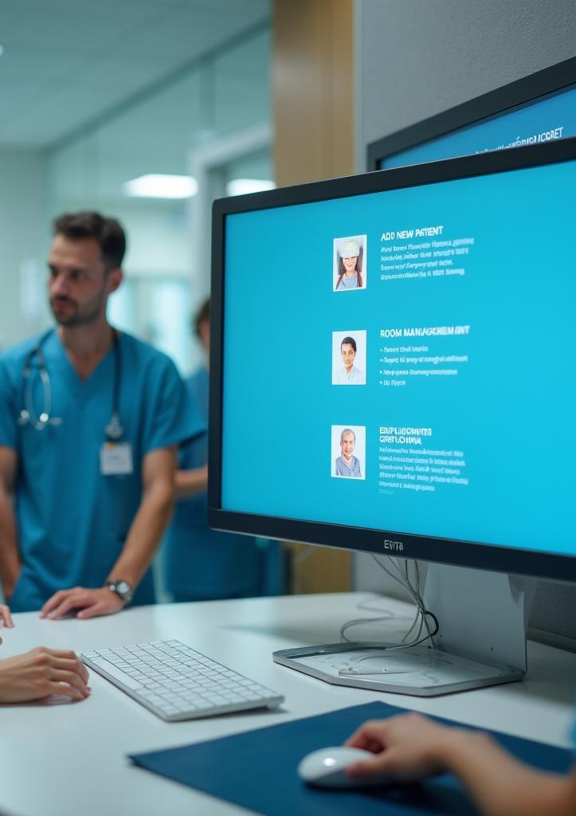
Navigation to Classes
The reception interface provides easy navigation to various classes essential for efficient hospital management. Users can quickly access modules such as 'Add New Patient', 'Room Management', and 'Employee Information'. This navigation is designed to enhance user experience, allowing for seamless transitions between tasks and ensuring timely operations.

Slide 7

02
Core Features

Slide 8
Patient Management
The patient management system allows for the comprehensive handling of patient records. This includes functionalities for adding new patients, updating existing records, and managing patient discharges. The system ensures that all relevant patient details are accurately recorded, providing healthcare professionals with instant access to critical information.

Slide 9
Room Availability Check
This feature allows users to monitor the availability status of hospital rooms in real-time. The system notifies staff whether rooms are occupied or unoccupied, supporting efficient space management and facilitating quick admissions of new patients. This helps in optimizing the use of hospital resources and improving patient flow.

Slide 10

Employee and Patient Information
The platform provides a comprehensive overview of employee and patient information. It includes detailed records such as employee roles, contact information, and patient medical histories. This centralization of information helps streamline communication across departments and enhances the quality of care provided to patients.

Slide 11
Conclusions
The Hospital Management System is designed to improve operational efficiency, enhance patient care, and streamline administrative processes. By leveraging real-time data, the system ensures that healthcare providers have the necessary tools and information at their fingertips, ultimately leading to better outcomes for both patients and staff.

Slide 12
Thank you!
Do you have any questions?
www.yourwebsite.com
+00 000 000 000

